Slide 1





Tech Titans
Intelligent Indoor OR Outdoor Surveillance Camera with AI Detection and Programmable Relay Control
Group 01
Tech Titans
P.R.H.N.G THILAKARATHNE
1357

Slide 2

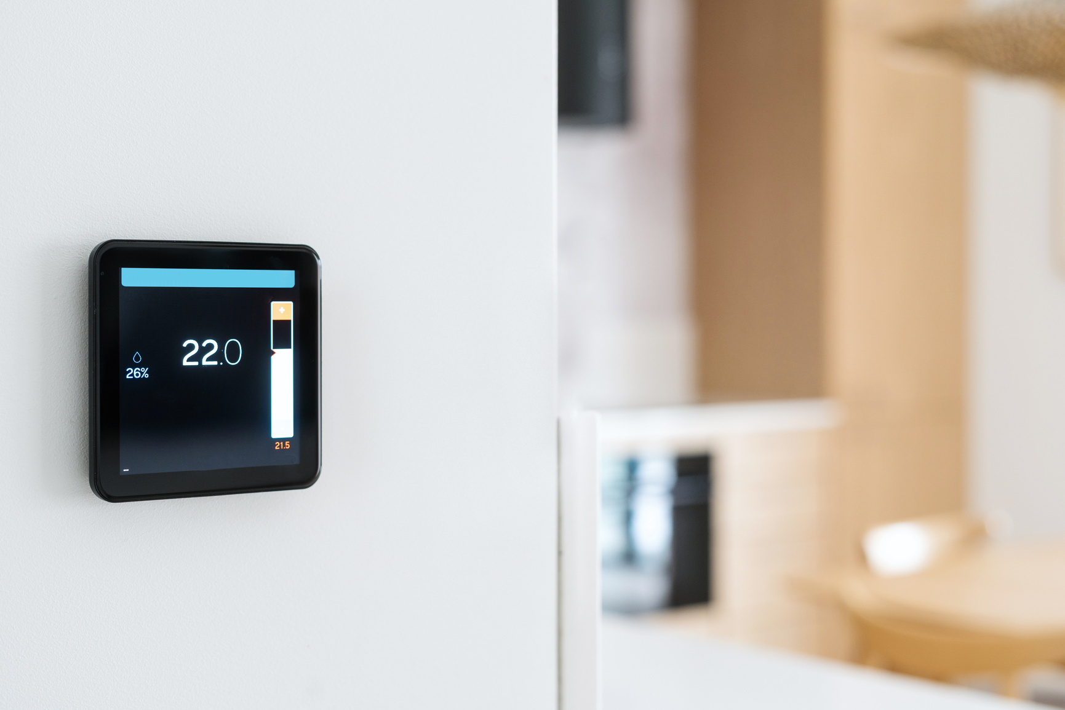

Introduction
Home security is increasingly crucial as traditional CCTV systems face challenges like high costs, complex installations, and limited functionality. This project aims to develop an intelligent surveillance camera system using AI detection and programmable relay control, providing a cost-effective, user-friendly solution for modern security needs.
1357

Slide 3

Problem Statement
Traditional CCTV systems face challenges like high costs, complex installations, and limited features, hindering effective security. This project develops an AI-powered surveillance system with advanced functionalities, leveraging cloud technology and mobile apps for accessible, efficient, and user-friendly security management.
1357

Slide 4



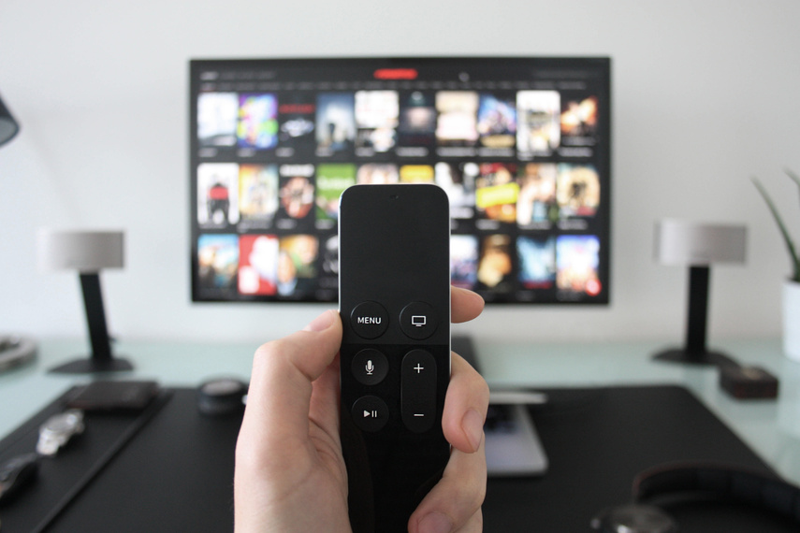
Scope of the Project
ESP32-CAM WIFI IP Camera Setup of a 2MP ESP32-CAM module for live video recording.
AI-Powered Object Detection Integration of YOLOv8 for real-time object identification and classification.
Cloud-Based Live Streaming Development of a secure platform for streaming live video feeds.
Video Recording and Playback Mobile app control for video recording, storage, and playback.
Programmable Relay Control Control external devices (e.g., lights, alarms) remotely via the app.
Flutter Mobile Application A user-friendly cross-platform app for monitoring and controlling devices.
Security Alerts and Notifications Intelligent, customizable alerts for event monitoring.
1390

Slide 5

Aim & Objective
Aim
To increase productivity in the workplace, we can utilize time management applications, as well as collaboration tools. In addition, ergonomic workspace arrangements can also help maintain focus and comfort while working.
1390

Slide 6
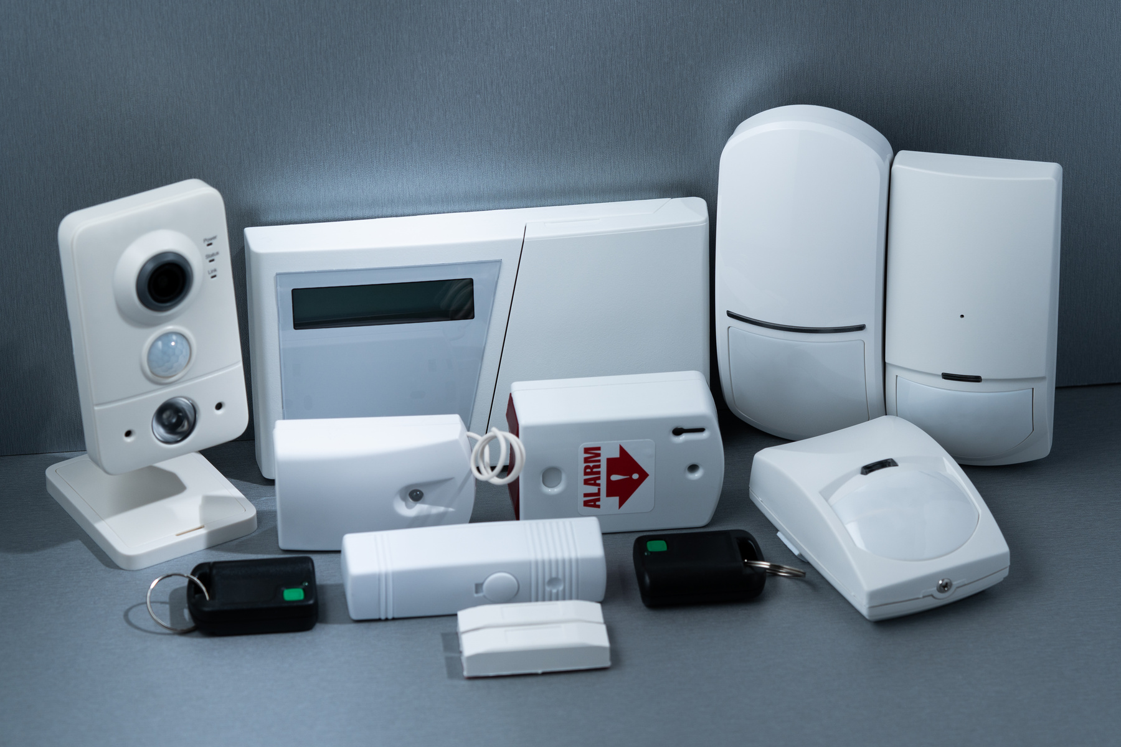
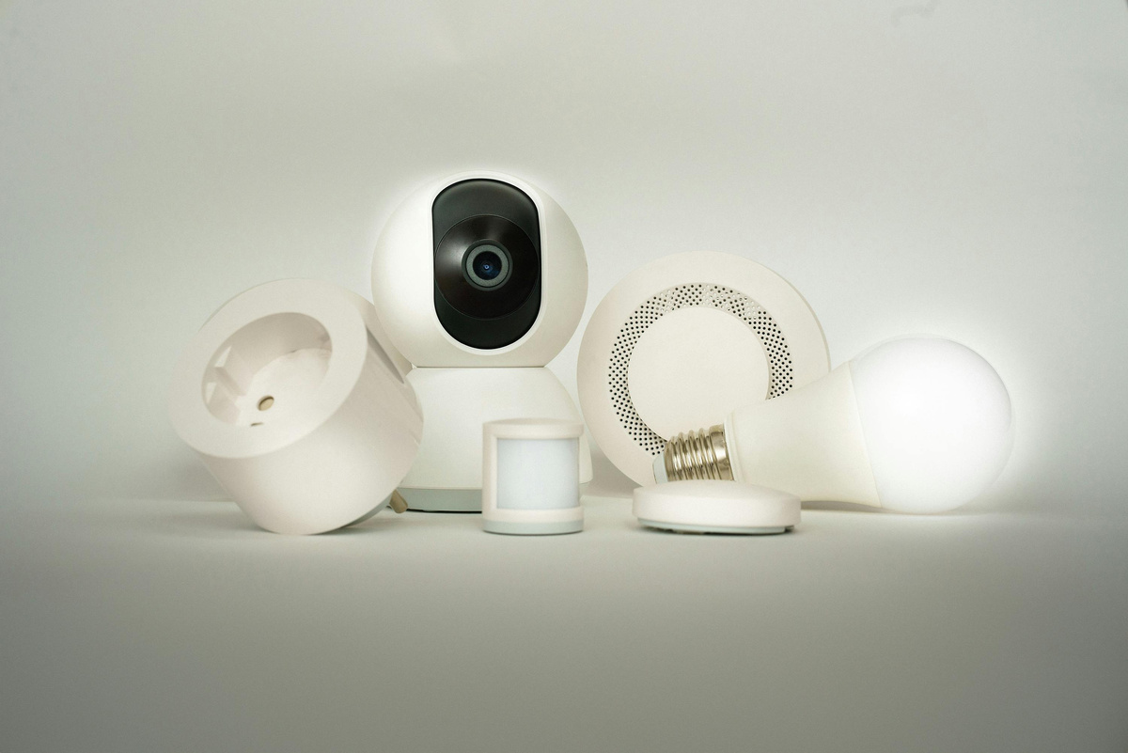
Objective
Develop the ESP32-CAM
Implement AI Object Detection
Enable Cloud-Based Streaming
Facilitate Video Recording
Integrate Relay Control
Create a User-Friendly Mobile App
Enhance Security Notifications
1390

Slide 7
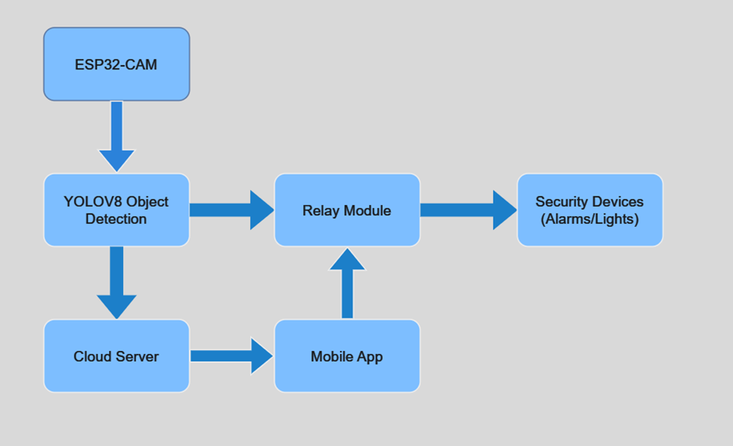
System Architecture design
1343

Slide 8
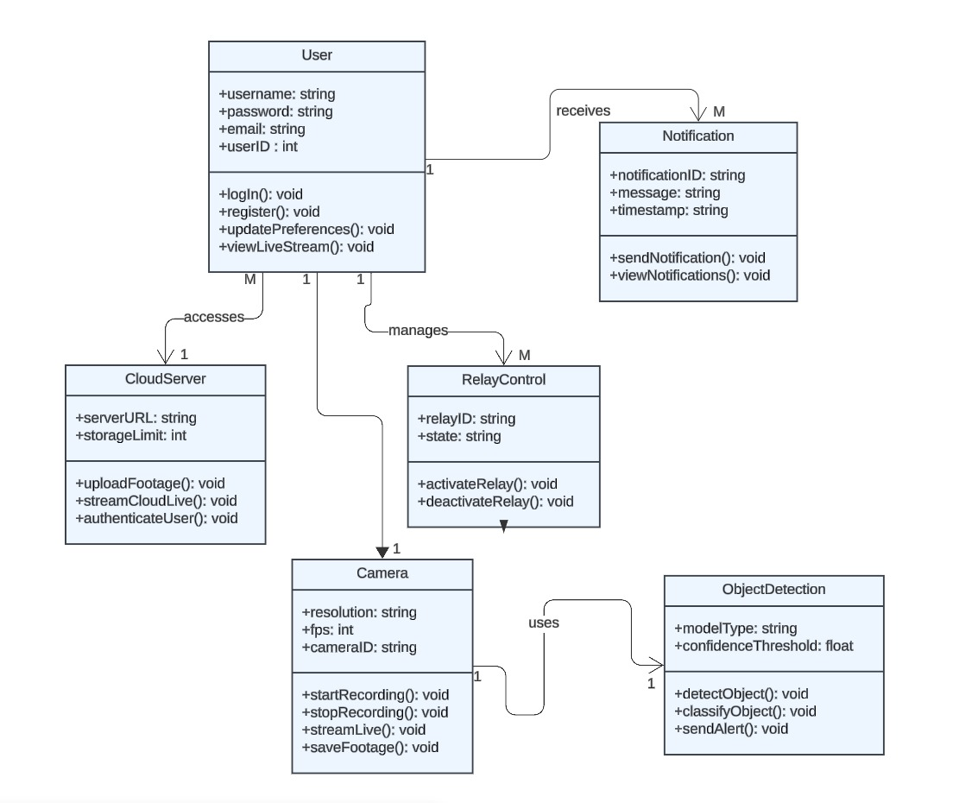
Class digram
Health tracker
1343

Slide 9
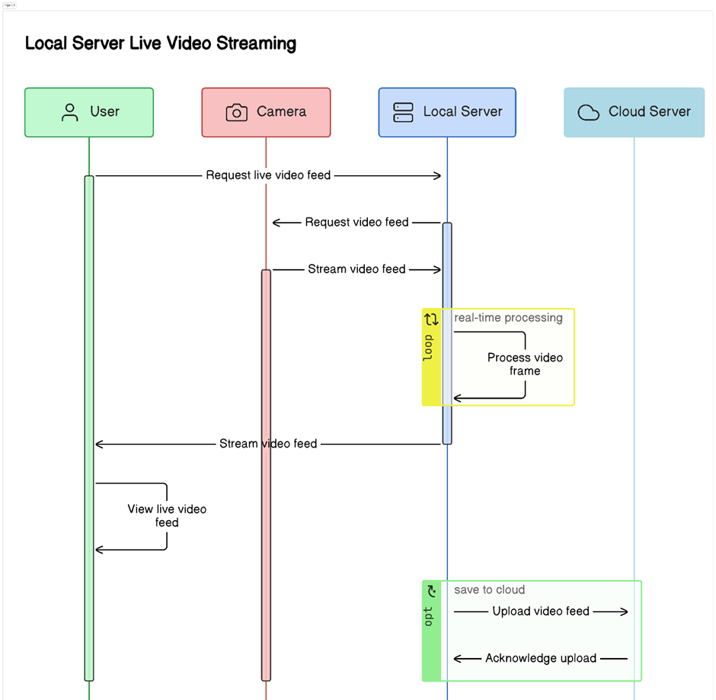
Sequence diagram
1297

Slide 10
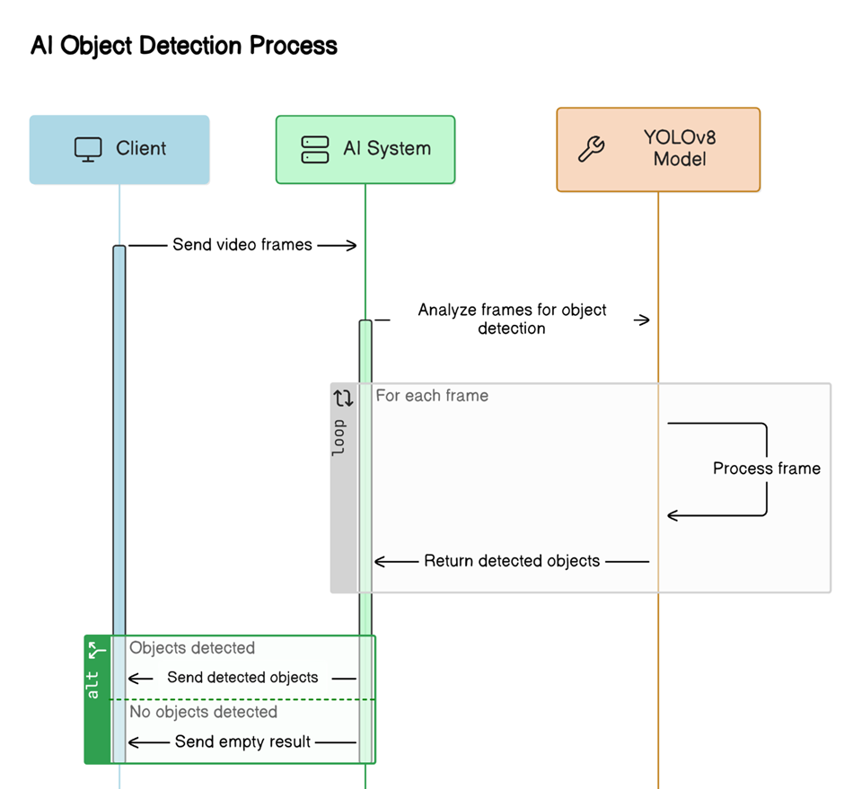
Sequence diagram
1297

Slide 11
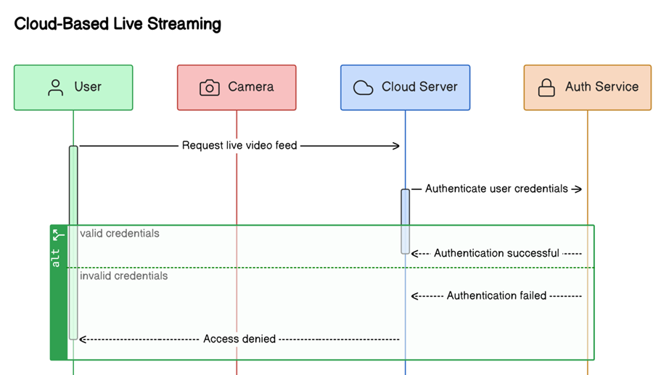
Sequence diagram
1297

Slide 12
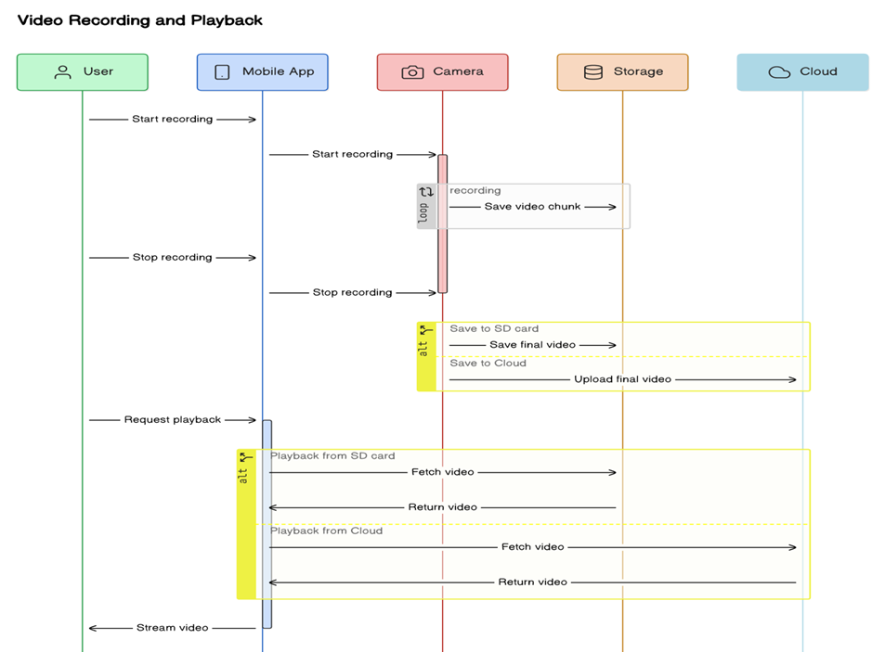
Sequence diagram
1297

Slide 13
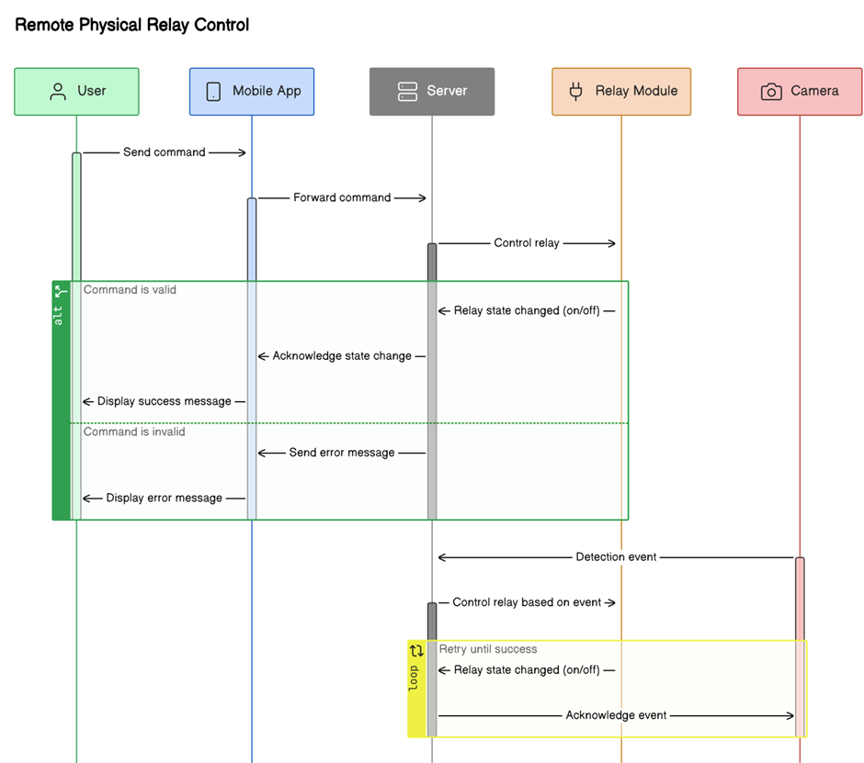
Sequence diagram
1297

Slide 14
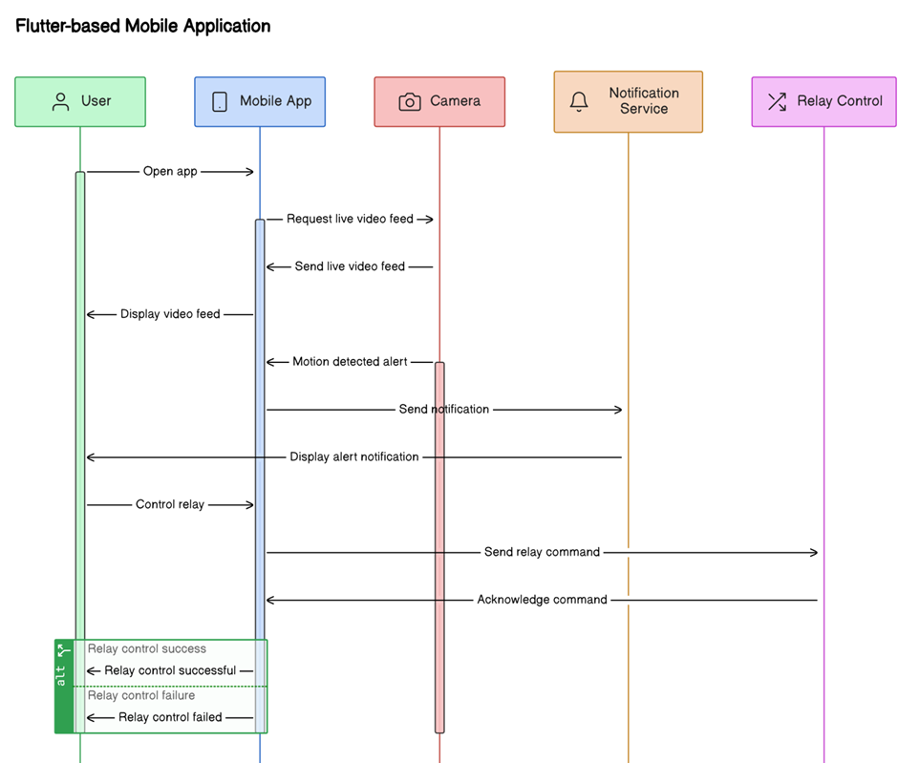
Sequence diagram
1297

Slide 15
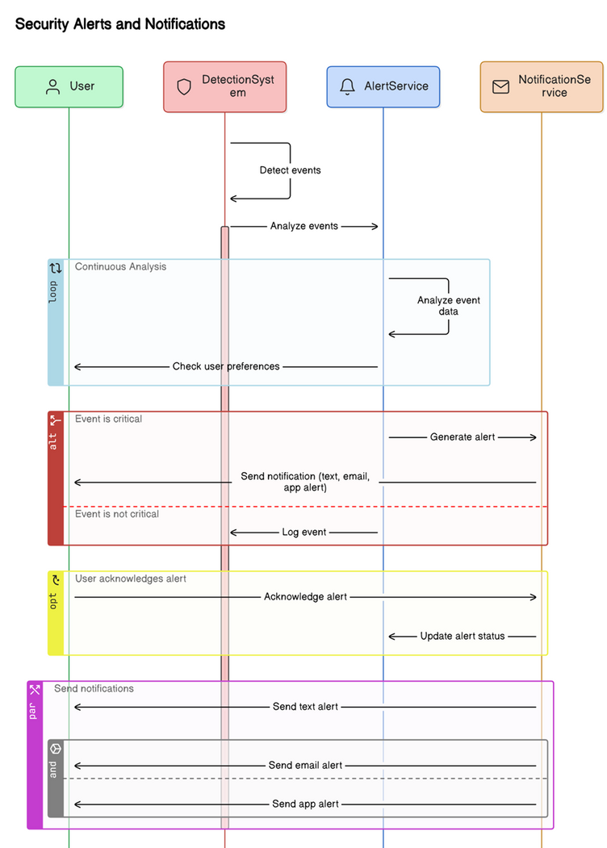
Sequence diagram
1297

Slide 16
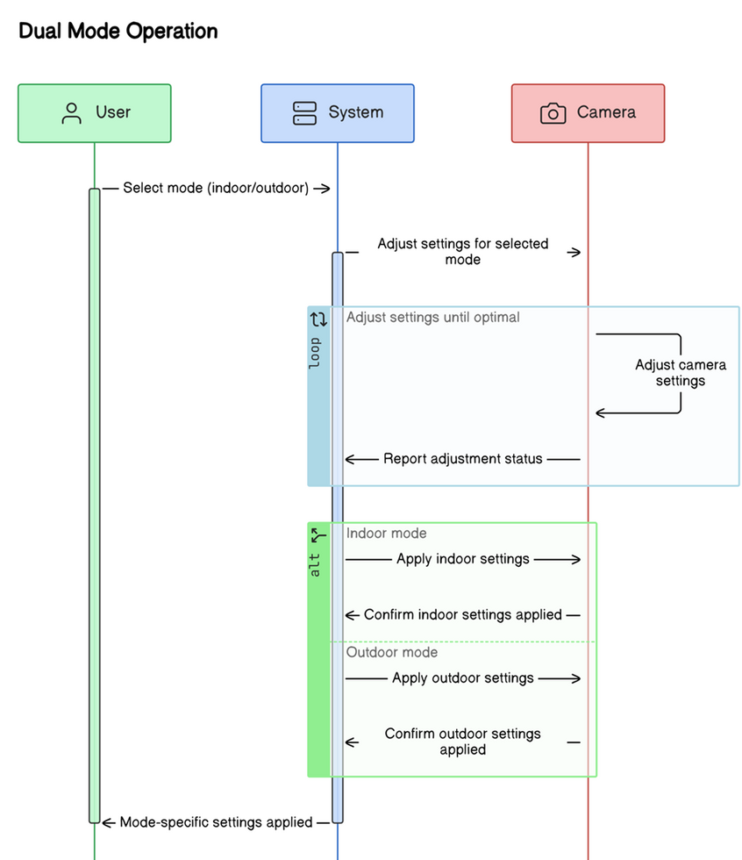
Sequence diagram
1297

Slide 17

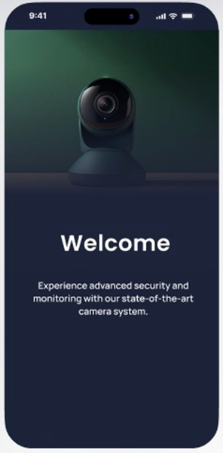
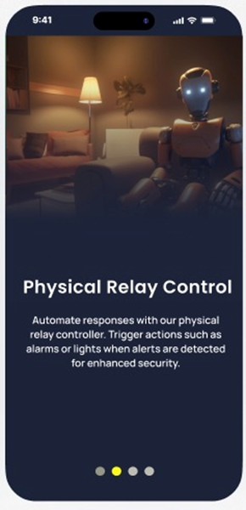
Interfaces of the system
Startup interface
Startup interface
Startup interface
1348

Slide 18
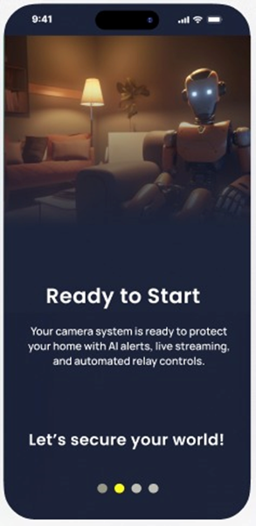
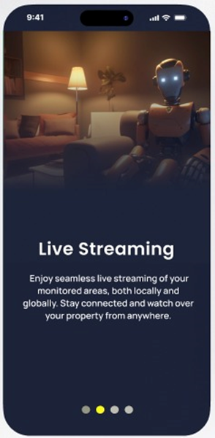
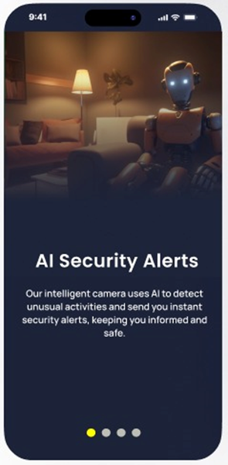
Interfaces of the system
Startup interface
Startup interface
Startup interface
1348

Slide 19
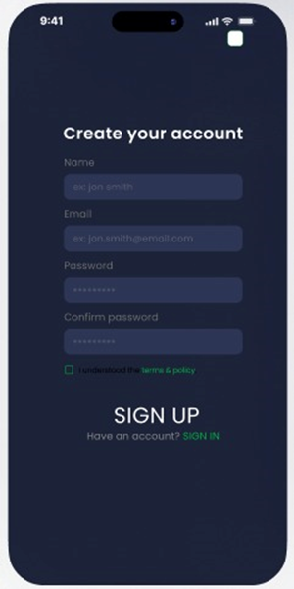
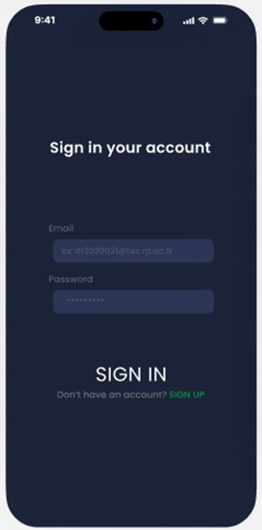
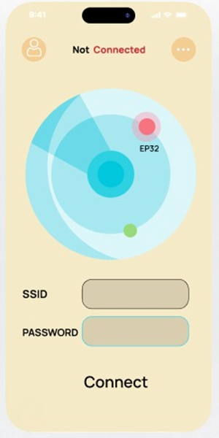
Interfaces of the system
Signup interface
Sign in interface
connect camara interface
1348

Slide 20
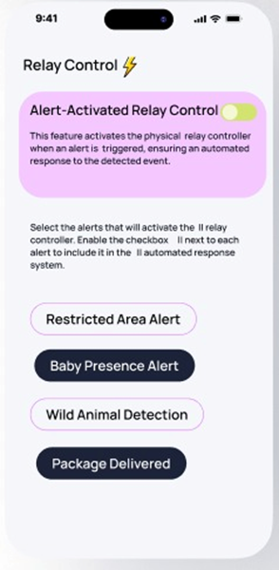
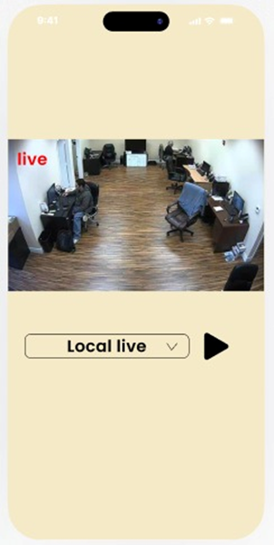
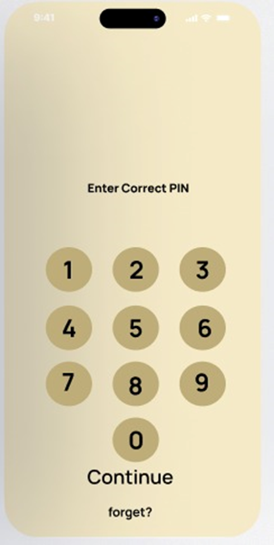
Interfaces of the system
PIN interface
Home interface
Relay Control interface
1348

Slide 21
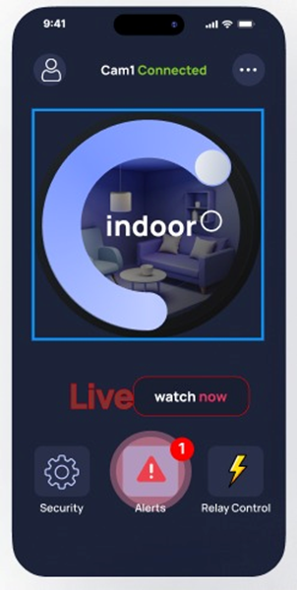
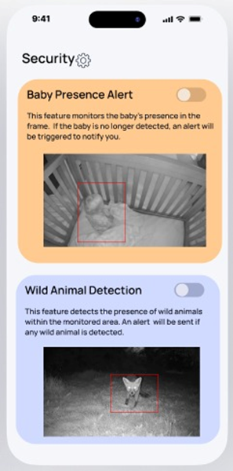
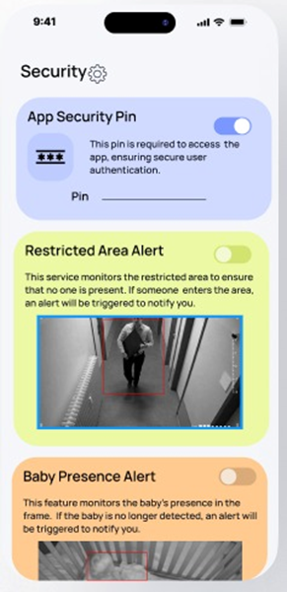
Interfaces of the system
indoor Streaming interface
Security interface
Security interface
1348

Slide 22
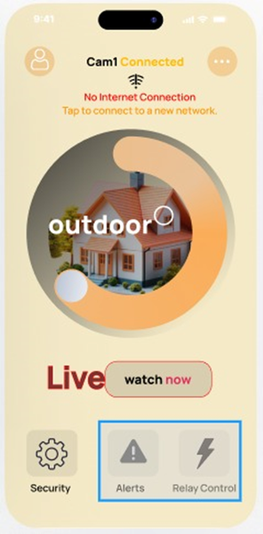
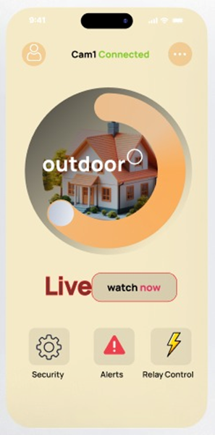
Interfaces of the system
outdoor Streaming interface
outdoor Streaming interface
1348

Slide 23
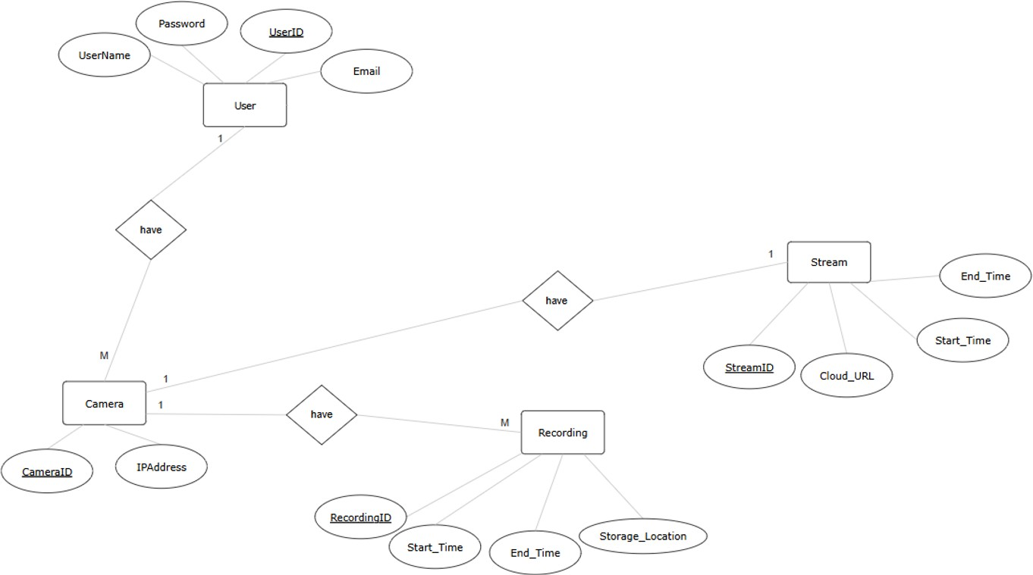
Conceptual database design
Automation
1348

Slide 24
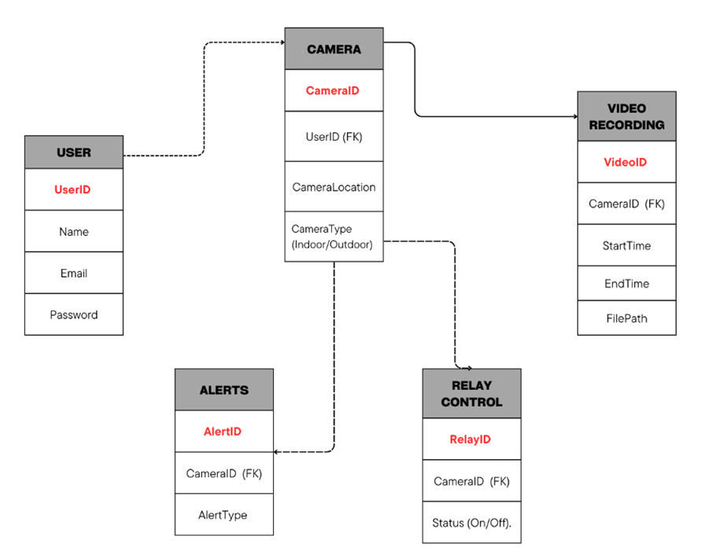
Logical database design
1363

Slide 25
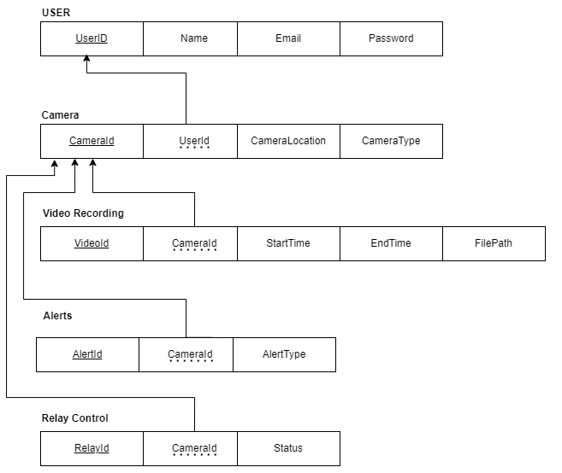
Schema refinement
IP Address
1363

Slide 26
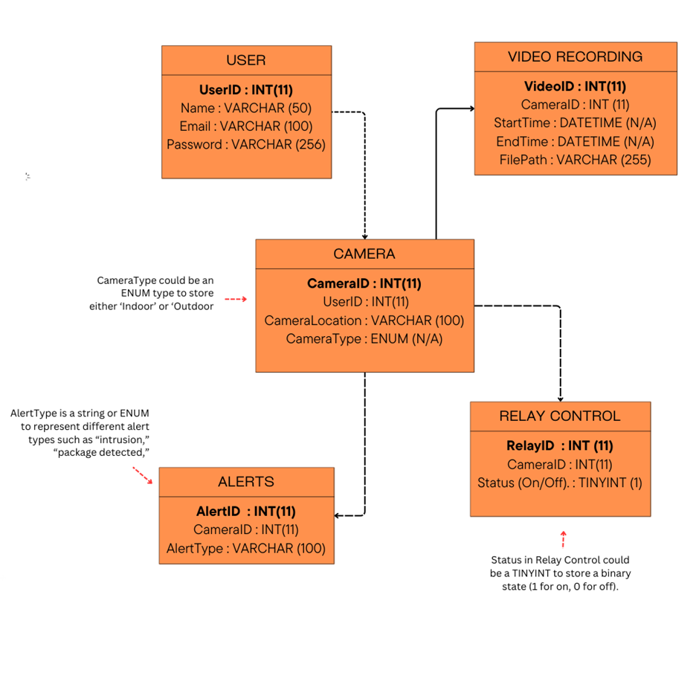
Physical database design
1363

Slide 27
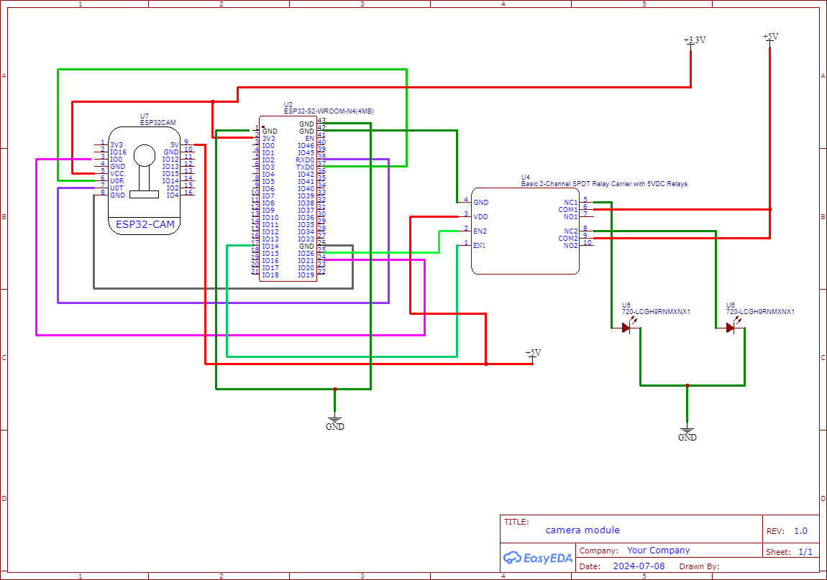
Hardware design
Hardware Design
1383

Slide 28
Group members
Name | Registration ID | Index No.
E.M.S.M. Edirisooriya | ITT/2020/021 | 1297
D.H.D. Prabhasha | ITT/2020/078 | 1348
H.L.I.N. Liyanaarachchi | ITT/2020/128 | 1390
P.W.D.I.M. Rodrigo | ITT/2020/091 | 1357
B.M.K.L. Bandaranayake | ITT/2020/121 | 1383
K.R.N. Perera | ITT/2020/072 | 1343
A. Sanjayan | ITT/2020/097 | 1363
1383

Slide 29
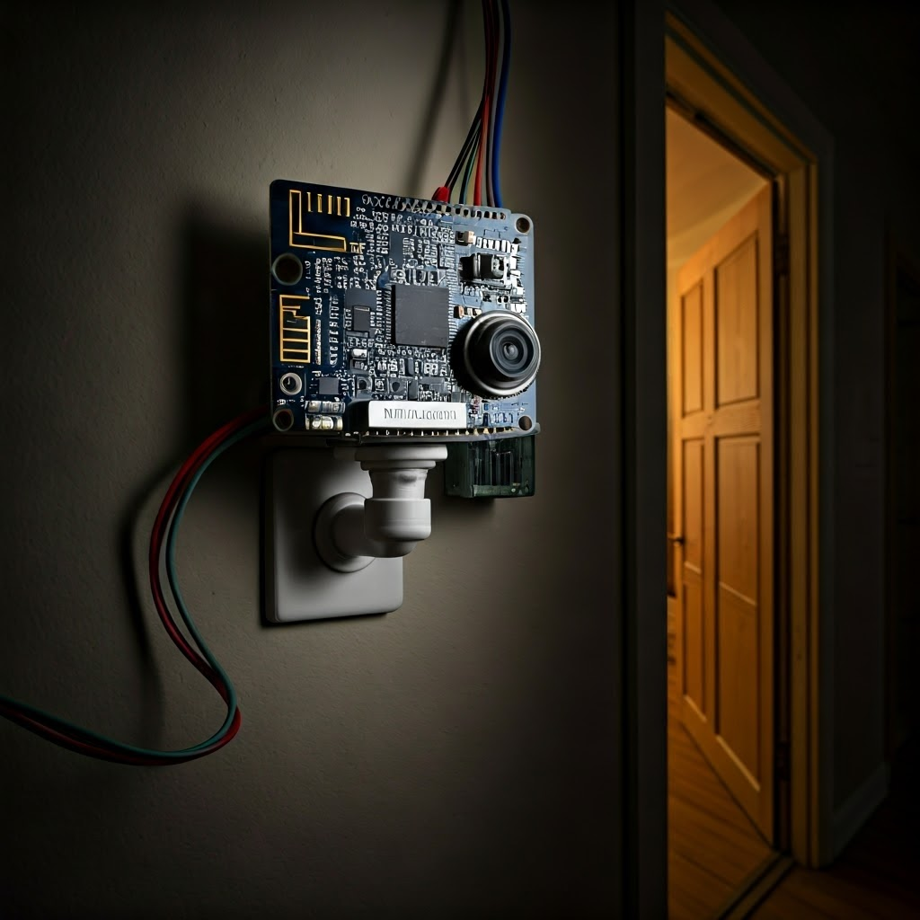

THANK
YOU!
1383

Slide 30
Q
&
A
1383

